Slide 1
Student Voice and Choice
Promoting Student Voice in Tech Decision Making

Slide 2
Introductions
Alyssa Richard, District TSVI, Victoria, British Columbia
Kari-Ann Pearce, District TSVI, Abbotsford & Chilliwack, BC
Kim Heinrichs, SET-BC TSVI, Vancouver, BC

Slide 3
British Columbia

Slide 4
SET-BC
Provincial Outreach Program
Setbc.org
Provides access technology to K-12 students
Vision, Access, Communication
Collaborative Process: SET team, school team, student

Slide 5
Why talk about Voice and Choice??
Individuals have individual needs and preferences
Embracing tech vs tech abandonment
Better experience and outcomes for student
Cost
Goldilocks "just right" choice = Better Support and Success!

Slide 6
Why talk about Voice and Choice?
Expanded Core Curriculum Connections
Self-Determination Skills
Career and Vocational Skills
Access Technology Skills

Slide 7
What evidence do you have that this is a good idea
Research
Personal preference was a determining factor in what devices a student used - D'Andrea, 2012
When a collaborative approach was used, individuals felt that they received the 'right' AT –Johnston et al, 2014

Slide 8
What evidence do you have that this is a good idea
"Without personal investments, willing adoption of new technology can be difficult." Siu and Presley, 2019

Slide 9
What evidence do you have that this is a good idea
Reflection and Feedback from students and members of the student team
TSVI and SET-BC educator questionnaire

Slide 10
How can we include student voice?
Checklists and Data Collection
Informal conversations
Collaborative Assessment (Participation Model)
Observations of school team and family

Slide 11
Examples
Stories/case studies, video, quotes from students, staff, parents
Student evaluations

Slide 12
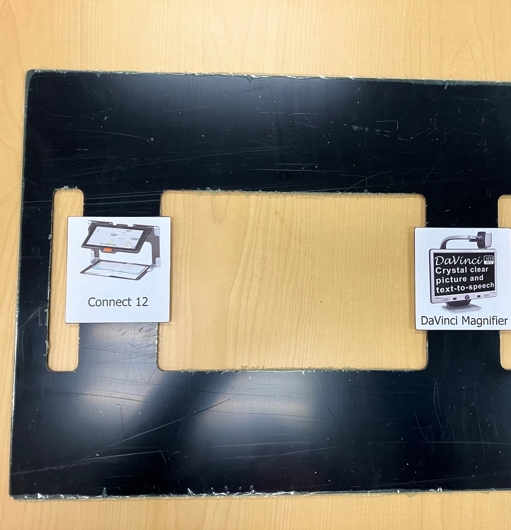
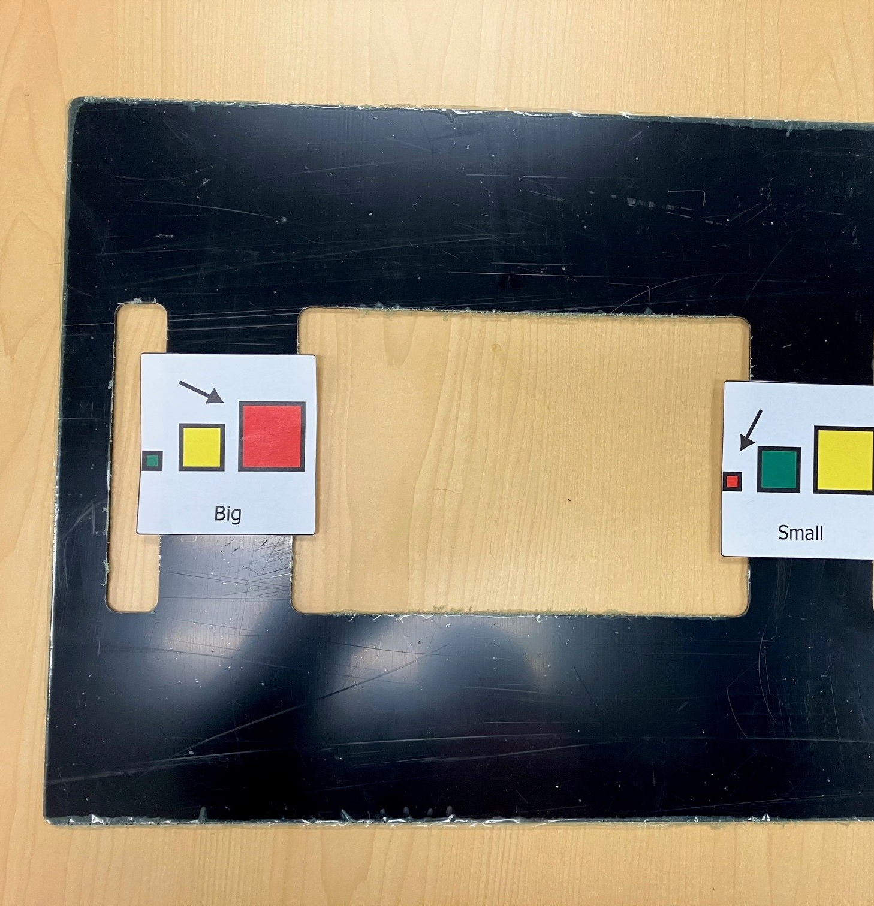
E-Tran

Slide 13
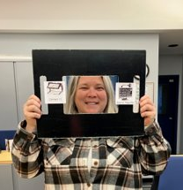
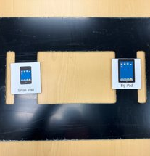
E-Tran 2

Slide 14
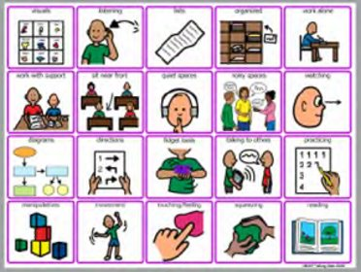
Communication board

Slide 15
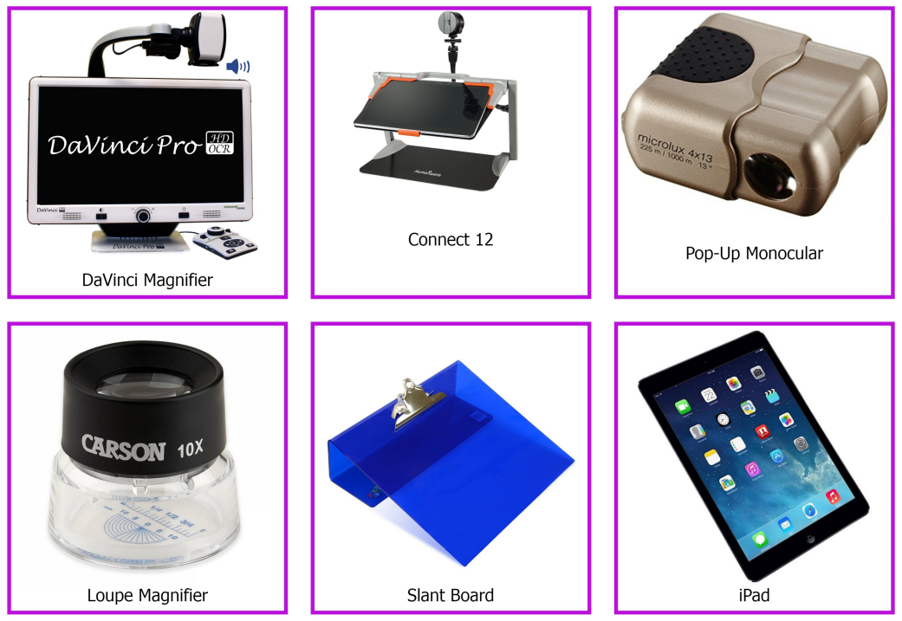
Communication Board 2

Slide 16
Simple Student Feedback
Easy or Hard?
Is using the tool easy or hard for you?
👍 (Easy)
😐 (Neutral)
👎 (Hard)
Helpful or Not?
Does the tool help you with your work?
👍 (Helpful)
😐 (Neutral)
👎 (Not Helpful)
Colors and Buttons:
Can you change colours or press buttons on the tool?
👍 (Yes, easily)
😐 (Yes, but it's a bit tricky)
👎 (No)
Comfortable or Uncomfortable?
How do you feel when you use the tool?
😊 (Happy)
😐 (Neutral)
😟 (Uncomfortable)

Slide 17
Student feedback
Tech Trials __________
Name of Equipment:
Dates tried:
Please be as specific as possible – when used, (e.g. for a subject? type of task, paired with another tech piece, set-up details?)
Pros
Cons
Additional thoughts

Slide 18
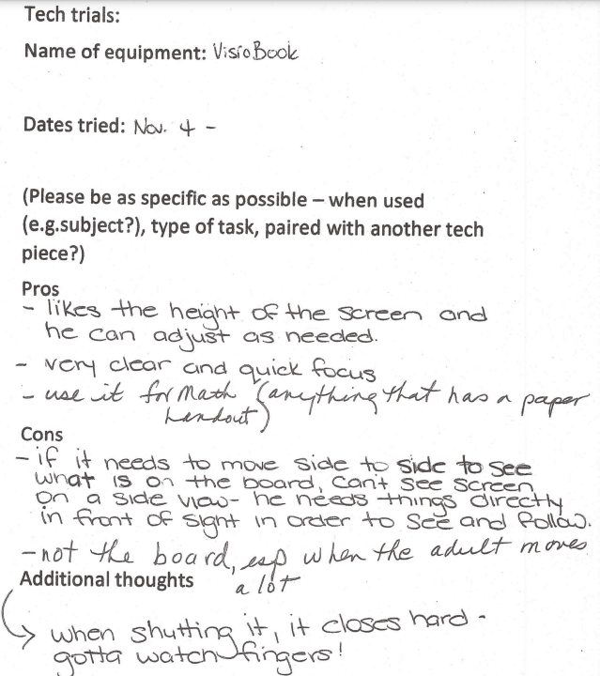
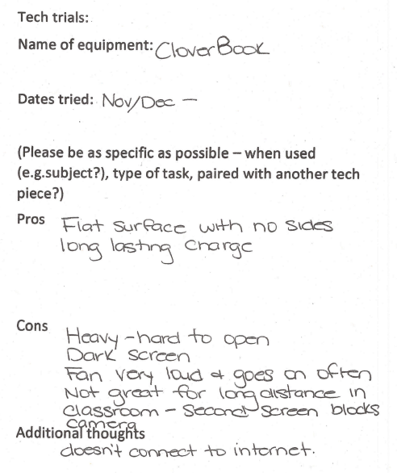
Student feedback filled in

Slide 19
Video

Slide 20
How to prepare for tech trials
Reflect on your own comfort level and preferences re tech
Know your student/build relationship
Be excited! Tech is awesome!
Step-by-step

Slide 21
Questions?

Slide 22
Merci!
Back to bed or the beach

Slide 23
Research and Resources
Access Technology for Blind and Low Vision Accessibility – Yue-Ting Siu & Ike Presley, 2019
Getting it "right": how collaborative relationships between people with disabilities and professionals can lead to the acquisition of needed assistive technology – Johnston et al., 2014
Guiding Teachers of Students with Visual Impairments to Make Assistive Technology Decisions: Preliminary Experience Using the Wisconsin Assistive Technology Initiative – Meng EE Wong, 2019
Preferences and Practices Among Students Who Read Braille and Use Assistive Technology – Frances Mary D’Andrea, 2012

